Slide 1
File Operations in Python

Slide 2

Contents
What is File Format
Why understanding file formats
Various File formats
Reading and writing data to text files
Reading and writing data to pdf

Slide 3
What is a file format
File format is a standard way of encoding information to store it in a file.
File format is nothing but structure of a file that tells a program how to display its contents
Firstly, a file format specifies whether the file is a binary file or ASCII file
Secondly it shows how the information is organized.
Some standard example is csv file format which stands for comma separated values file and stores all the data separated with a comma.

Slide 4
Why understanding different file formats
Usually, the type of file and its format depends on the application we are using for
We might come across many types of files such as audio, video and text etc.
Text files being the most used and simplest formats of all types
Text files have various formats, we need to understand each and every possible file format and the way in which the information is stored inside the file.
Unless we understand and know how the data is stored and displayed in specific file format we can’t explore and manipulate the data well from that file.

Slide 5
File Formats
Now let’s investigate various file formats, their structure and how data is stored in them. Also, how to use those file formats in python.
CSV – Comma separated Value
TSV – Tab Separated Value
XLSX – Microsoft excel open XML spreadsheet
TXT
JSON – Java Script Object Notation
XML - Extensible Markup Language
ZIP
HTML – Hyper Text Markup Language

Slide 6
CSV (Comma Separated Values)
Comma Separated values file format falls under spread sheet file format
Each line in a csv file is called a record
Each record may contain one or more than one value separated by a comma
Each record is separated from another record with a new line delimiter, which means each record in a csv file ends with a new line character and doesn’t have a trailing comma at the end

Slide 7
TSV (Tab Separated Values)
Tab Separated values file format falls under spread sheet file format
Tab separated values files format is similar to csv file format
Each record may contain one or more than one value separated by a tab
Each record is separated from another record with a new line delimiter, which means each record in a tsv file ends with a new line character and doesn’t have a trailing tab at the end

Slide 8
TSV
CSV
First name,Last Name,Mobile,Country
Steve,Smith,23456182,Australia
Mitchell,Clarke,3452184,USA
Happy,May,142783452,Canada
Sheldon,Cooper,23451672,Trinidad
Sam,Billings,345217926,England
First name Last Name Mobile Country
Steve Smith 23456182 Australia
Mitchell Clarke 3452184 USA
Happy May 142783452 Canada
Sheldon Cooper 23451672 Trinidad
Sam Billings 345217926 England

Slide 9
XLSX format
This also falls under Spreadsheet file category
Data is stored in cells. Each cell is organized in rows and columns.
A column can have different types.
XLSX files can be opened using only applications which support the file format.
They can be opened by Microsoft excel. For example, if an excel file is opened with a normal text editor like notepad it displays the encodings but not the data.

Slide 10
JSON
JSON stands for Java Script Object Notation
JSON is a lightweight data interchange format
JSON data format is similar to java script object notations
JSON syntax is derived from Java script objects:
Data is in the form of key/value pairs
Data is separated by commas
Curly Braces hold objects
Square brackets hold arrays

Slide 11
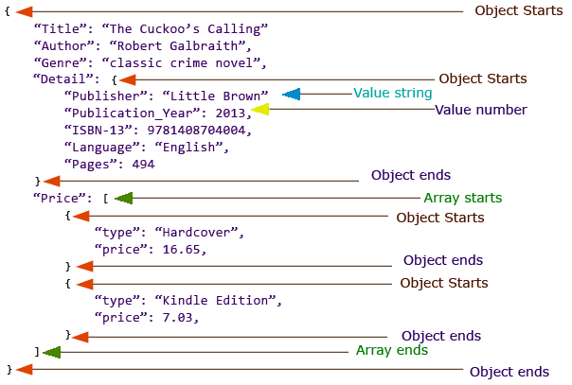
JSON (Java Script Object Notation)
This image shows different parts in a json file.

Slide 12
ZIP files
Zip file is an archive file format and has an extension .zip
In Archive file format, you create a file that contains multiple files along with metadata. An archive file format is used to collect multiple data files together into a single file. This is done for simply compressing the files to use less storage space.
So, a ZIP file format is a lossless compression format, which means that if you compress the multiple files using ZIP format you can fully recover the data after decompressing the ZIP file.

Slide 13
Handling ZIP file in Python
We can work with Zip files by importing the zipfile package in python
ZipFile is a class of zipfile module for reading and writing zipfiles
ZipFile constructor is used to open zip file in read or write mode
ZipFile.printdir() method is used to print all the contents of zip file
ZipFile.extractall() method is used to extract all the contents of the zip file and store them in the current working directory.

Slide 14
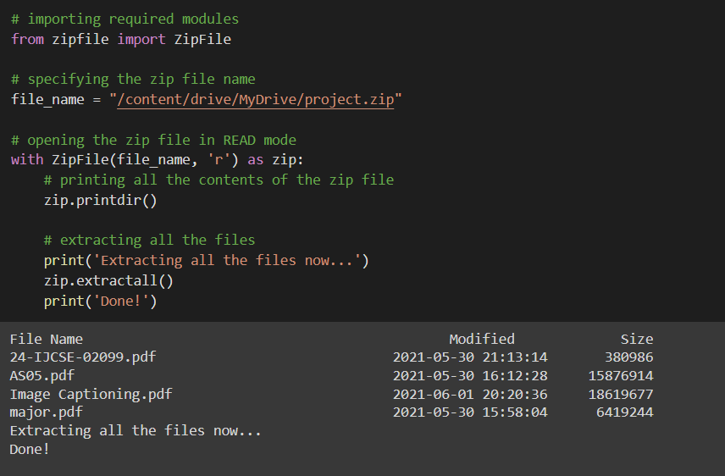
Handling ZIP file in Python

Slide 15
Plain Text file format
Plain text file format has an extension .txt
This text is unstructured and there is no metadata associated with the text
The txt file can be easily created and read by using any program
Interpreting data and analyzing data in a text file is very difficult because it doesn’t represent any standard structure
Text files are generally useful when you want to load a huge amount of unstructured paragraphs of data for applications such as NLP

Slide 16
Handling text file in Python
Text file handling doesn’t require any special library to be used
open(filename,accessmode) method creates a file object pointing to the specific file.
Access Modes of opening the file are
‘r’ – read-only mode
‘r+’ – read and write mode
‘w’ – write-only mode
‘w+’ – write and read mode
‘a’ – append-only mode
‘a+’ – append and read mode

Slide 17
Handling plain text file in Python
file.close() is used to close a file
file.write() is used to write a single line and writelines() is used to write a set of lines each at a time
File.read(n) reads n bytes from the file, if n is not specified reads the entire file
readlines() reads all the lines and return them as each line a string element in a list

Slide 18
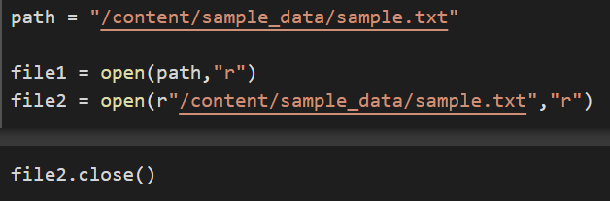
Opening and closing Text files
Let’s open a sample text file in read mode.
file.close() is used to close a file
The file should exist in the same directory as the python program file else, the full address of the file should be written in place of the filename.
Note: The r is placed before the filename to prevent the filename string characters from being treated as special characters. The r makes the string raw, that is, it tells that the string is without any special characters.

Slide 19
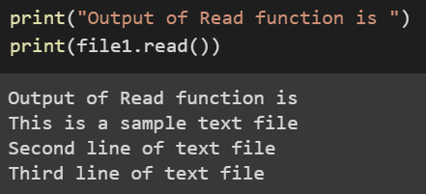
Reading data from Text files
There are three ways to read data from a text file.
read() :
Returns the read bytes in form of a string.
Reads n bytes, if no n specified, reads the entire file.
File_object.read([n])

Slide 20
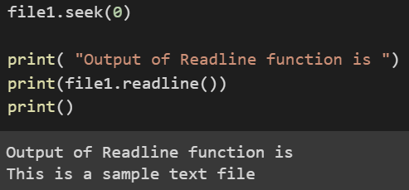
Reading data from Text files
readline() :
Reads a line of the file and returns in form of a string. For specified n, reads at most n bytes. However, does not reads more than one line, even if n exceeds the length of the line.
File_object.readline([n])
seek(n) takes the filehandle to the nth bite from the beginning.

Slide 21
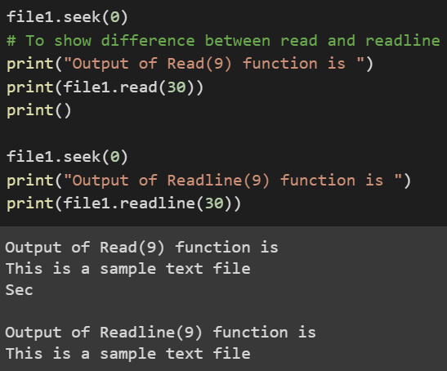
Reading data from Text files
read() vs readline() :
Readline(): For specified n, reads at most n bytes.
However, does not read more than one line, even if n exceeds the length of the line.

Slide 22
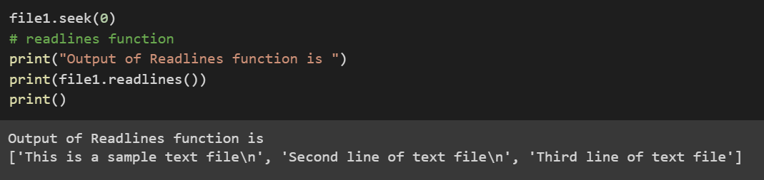
Reading data from Text files
readlines() :
Reads all the lines and returns them as each line a string element in a list.
File_object.readlines()

Slide 23
Writing data to Text files
There are two ways to write in a file.
write() :
Inserts the string str1 in a single line in the text file.
File_object.write(str1)
writelines() :
For a list of string elements, each string is inserted in the text file.
Used to insert multiple strings at a single time.
File_object.writelines(L) for L = [str1, str2, str3]

Slide 24
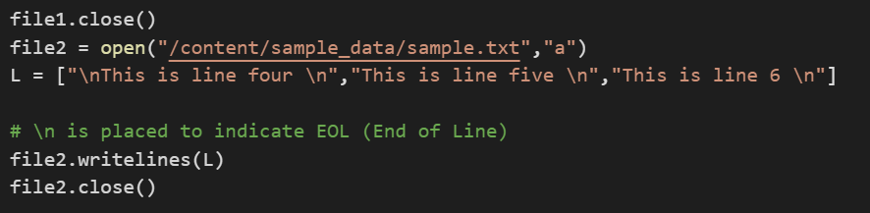
Writing data to Text files
While writing data to a text file, we can either append the data to already existing data or erase the existing data and write the new data.
By using append access mode we can append data to an existing file.

Slide 25
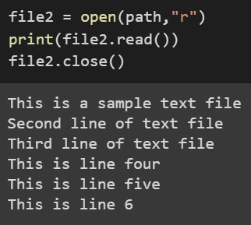
Writing data to Text files
Below is the content of the text file before the append operation is performed.
As we can see the data got appended to the existing data in the file.

Slide 26
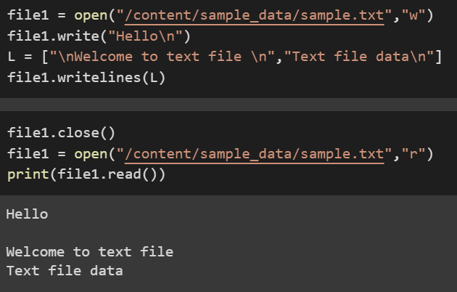
Writing data to Text files
Opening the file in writing mode erases the existing data from file and writes the data into the file.

Slide 27
PDF files
PDF stands for Portable Document Format
It is a versatile file format created by adobe
PDF files are system and operating system independent and hence is a reliable document exchange file format that can be accessed regardless of the software, hardware, or operating systems being used by anyone who views the document.
They cannot be modified, thereby preserving the formatting of the file intact. Hence, they can be easily shared and downloaded. They are meant for reading and not editing

Slide 28
PDF file handling in Python
PyPDF2 is a python library used for processing data and performing operations on a PDF file such as extracting the document-specific information, merging the PDF files, splitting the pages of a PDF file, adding watermarks to a file, encrypting and decrypting the PDF files, etc.
Let’s discuss the following operations on PDF files.
Extracting document information
Extract text from PDF files
Write data to PDF files

Slide 29
Reading data from PDF files
First, we import PdfFileWriter and PdfFileReader from PyPDF2, these are the classes that write and read PDF files, respectively.
Then we create a PdfFileReader object out of a file opened in read-binary mode.
In PdfFileReader objects we can use getPage() to access the PDF page at the specified page number.
extractText() method on the PDFFileReaderObject created is used to extract the text from the specified page of the PDF file.

Slide 30
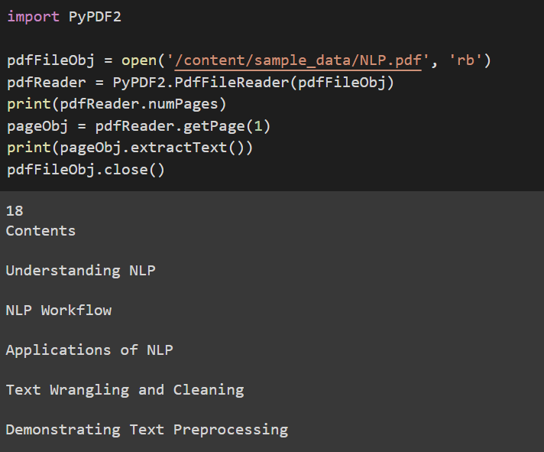
Reading data from PDF files

Slide 31
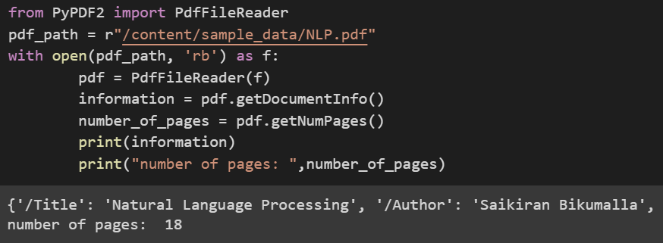
Extract Document information
PyPDF2 library has methods to get the metadata of the document.
create a PdfFileReader object out of a file opened in read-binary mode.
getDocumentInfo() method gives all the metadata information regarding the file

Slide 32
Writing data to PDF files
First, we import PdfFileWriter and PdfFileReader from PyPDF2, these are the classes that write and read PDF files, respectively.
Then we create a PdfFileReader object out of a file opened in read-binary mode.
We also construct a PdfFileWriter, it doesn't need any arguments passed to it.
addPage() method of a PdfFileWriter is called when we want to add a page, it takes a PDF page object as its argument.
Finally we call write() on the PdfFileWriter, supplying an open filehandle to write the PDF file into.

Slide 33
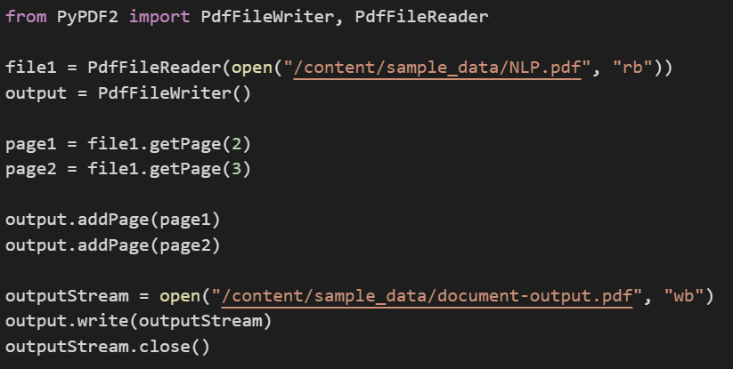
Writing data to PDF files

Slide 34
References
https://www.analyticsvidhya.com/blog/2017/03/read-commonly-used-formats-using-python/
https://pandas.pydata.org/docs/reference/api/pandas.read_csv.html
https://www.geeksforgeeks.org/different-ways-to-import-csv-file-in-pandas/
https://www.knowledgehut.com/tutorials/machine-learning/model-building-scikit-learn-python-library-machine-learning
https://towardsdatascience.com/generate-your-sample-dataset-a-must-have-skill-for-data-scientists-36ded8600b79
https://vitalflux.com/python-sklearn-how-to-generate-random-datasets/

